Slide 1
A presentation by No More Bombs
TPNW: Our Last Chance?
A presentation of No More Bombs

Slide 2
Treaty
Prohibiting
Nuclear
Weapons
Our Last Chance?
Notes:
This is our topic for the evening. The ICAN treaty banning nuclear weapons that just came into effect this year.

Slide 3
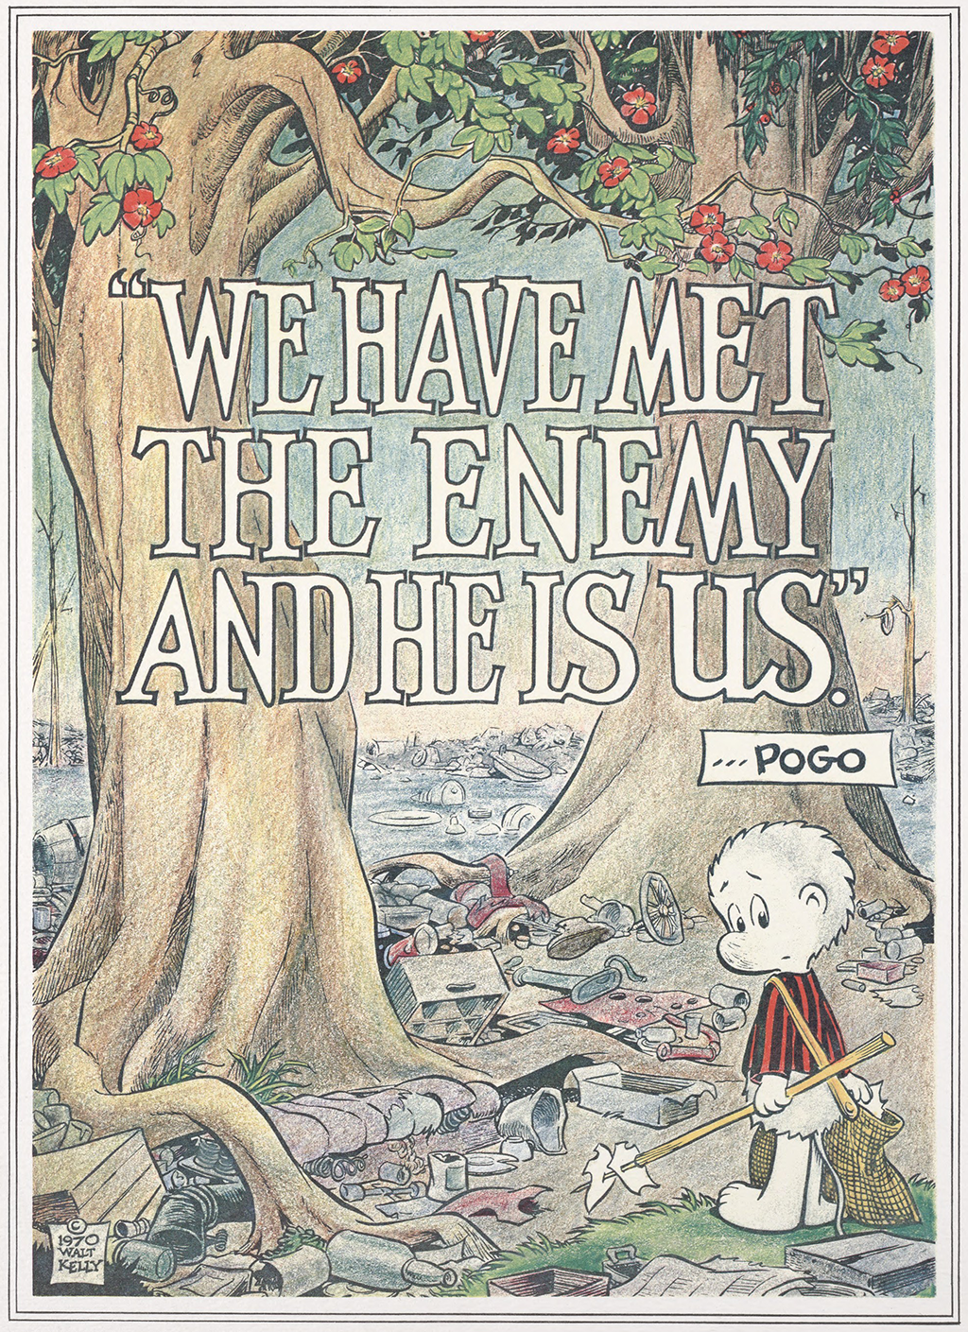
It ain’t just littering anymore.
This is serious shit.
Notes:
Apologies to Walt Kelly, but he warned us then, and many others have since, and we have ignored them all.

Slide 4
He is US
We are at a tipping point.
Several existential crises are converging, and we have no clue how to deal with any of them, let alone the many intersections among them all.
Climate change is spiraling out of control. Whatever corrections we try now may be too little and too late. Witness the recently concluded COP 26 in Glasgow.
Covid 19 has engulfed human populations all over the world. The disproportionate health effects and resultant mortalities among the poorest economies illustrate widespread inequalities in all societies.
Nuclear arsenals continue to expand in all 9 nuclear armed countries, to the financial benefit of a few multinational corporations, and threatening all life on earth more drastically every year.
We have no one to blame but ourselves.
Notes:
Any one of these trends could bring unimaginable catastrophe to all humans at least, and possible devastation to all living beings on earth.

Slide 5
And to add to our confusion, there is a bewildering array of acronyms to guide us.
Just in the field of nuclear weapons: these are three we will confront here
NPT
NPR
TPNW
Non-Proliferation
Treaty
United Nations,
1970
Nuclear Posture
Review
Every administration
since 1994
Treaty Prohibiting
Nuclear Weapons
United Nations,
2021
Notes:
The NPT has been in effect, on paper at least, for 50 years. As international treaties go, it is one of the most successful, in that it has not completely failed yet. The NPR is a regular assessment of the ongoing nuclear weapons strategy of the US. Completely outside of US influence, the TPNW is an international movement that is gaining momentum around the world, and even US policymakers are starting to take notice.

Slide 6
Nuclear Non-Proliferation Treaty
Because the first action taken by the United Nations in 1946 was to pass Resolution 1, which declared nuclear weapons to be incompatible with international peace and security, and established the First Committee to direct the work of nuclear disarmament, it was the UN that developed this treaty over 20 years later. It went into effect in 1970.
It was signed by 191 nations, including the 5 nuclear nations at that time: US, Russia, Britain, France, and China.
It is still in effect, and a review conference by signatory nations will take place next January.
Notes:
The Nuclear Non-Proliferation Treaty was adopted in 1970.

Slide 7
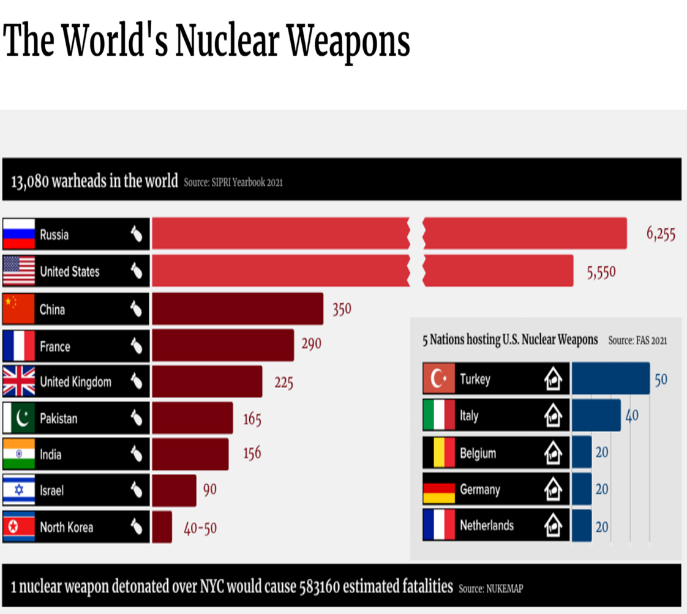
Non-Proliferation Treaty 1970
- United States had 26,008 nukes
-Russian Federation had 11,643
-United Kingdom had 394
-China had 75
-France had 36
- share peaceful uses of nuclear energy
- no new nations would develop nuclear weapons
- promised to pursue mutual warhead reductions to complete nuclear disarmament
But the nuclear virus spread to Israel, Pakistan, India, and North Korea →
-We are now engaged in a new arms race, taking the threat to a whole new level.
“Modernization”
today
Notes:
Progress has been made in the overall numbers of US and Russian arsenals, but refining the explosive power and destructiveness of the nukes still in service has greatly increased, and contrary to the promises they made in 1970, the nuclear weapons technology has spread to four more countries.

Slide 8
So far, the NPT and Blind Luck have kept us safe from global nuclear catastrophe.
Total numbers of nukes may have decreased, but the destructive potential of remaining warheads is far greater now.
Next up:
US Government’s internal Nuclear Posture Review
Notes:
Blind Luck! At the very least, we must not allow this treaty to go away.

Slide 9
Presidential
Legacy
Nuclear Posture Review
Regular re-assessment of how many nuclear weapons the US has, what types of warheads and carrying vehicles, and whether they meet the strategic needs at the time.
It is no surprise that every review has demanded more funding for nukes.
Who is making these decisions?
Who is benefitting?
Who pays?
Arms
Manufacturers
Defense
Department
Threatened
Peace and Security of the
Whole
World
US Taxpayers
Who really pays?
Notes:
This exercise takes place within each new US administration. No consultation with other countries. One hint that this one will not make the disarmament moves we all have expected from President Biden is the recent firing of the Deputy Assistant Secretary of Defense for Arms Control Policy Leonor Tomero. She had expressed some ideas about reducing the modernization budget and enhancing the warhead dismantling regime.

Slide 10
First Nuclear Posture Review 1994, 1993 US Nuclear Arsenal totaled 11,500 warheads.
President Bill Clinton.
Reaction to the previous nuclear arsenal downsizing begun under Ronald Reagan and continued by George H W Bush.
The NPR recommended expanding entire triad
More bombers, submarines, and ICBMs
Second Nuclear Posture Review 2002 2001 US Nuclear Arsenal was 10,500 warheads
President George W Bush
No cuts proposed, but it called for requiring the
"Pentagon to draft contingency plans for the use of nuclear weapons against at least seven countries, naming not only Russia and the ‘axis of evil’—Iraq, Iran, and North Korea—but also China, Libya and Syria.“
Notes:
The first one was a reaction to previous president George H W Bush’s continuing of Ronald Reagan’s downsizing of the nuclear arsenal. Clinton committed to more spending on nukes. The next Bush administration did too.

Slide 11
Nuclear Posture Review
Coming soon after President Barack Obama’s 2009 speech in Prague, this was expected to commit the US to serious reductions in nuclear warheads and systems.
In fact, the only move in that direction was to renew START negotiations with Russia.
What quickly emerged was “Modernization”: the 30 year program now underway to upgrade, rebuild, and replace the entire nuclear arsenal. This was the bargain: New START for Modernization.
2018 Nuclear Posture Review
Donald Trump not only exposed the modernization program for the
Military-Industrial-Complex’s Golden Opportunity that it is, the 2018 NPR went even farther, committing to weapons systems that had been considered and dismissed years ago.
As a result, down payments have already been made to manufacture new Short Range Missiles, experimental weapon systems like Hypersonic missiles, Sea Launched Cruise Missiles, and the new warheads and new plutonium pits that will arm them.
Notes:
New START was to replace the START I treaty between US and Russia signed in 1991 and expired in 2009. New START was adopted in 2015, but is due to expire next year if not renegotiated. Those negotiations have not resumed yet, while Modernization has already committed the US to spend billions more $ on new plutonium pits, new warheads, and new missiles.

Slide 12
2021 Nuclear Posture Review
is now underway
We shouldn’t be surprised when it promises more spending for more new weapons, and no substantive move toward disarmament.
Notes:
This is going on now, and we won’t know its outcome until next year.

Slide 13
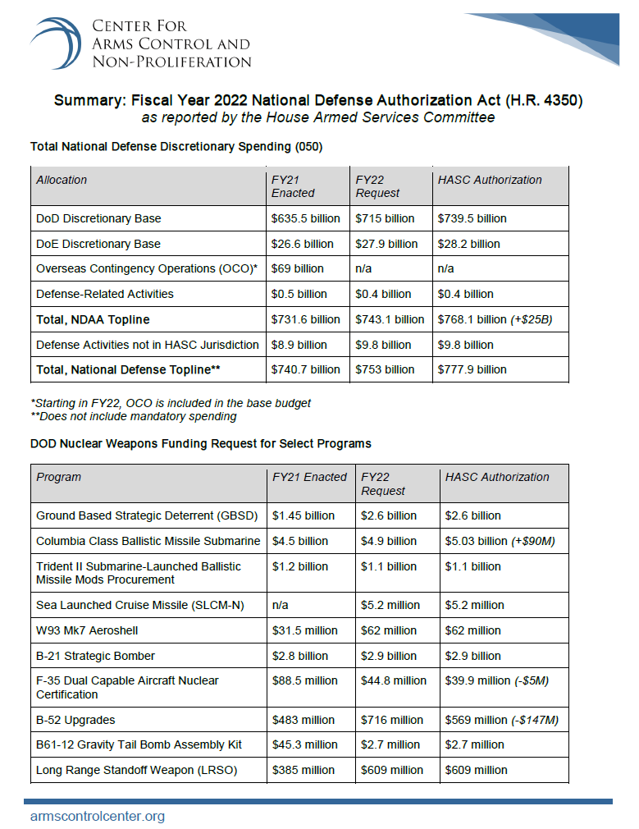
This is the 2022 Military Budget submitted by the House Armed Services Committee, September 16, 2021:
$778 Billion total, a 9.5% increase, of which
$18.14 Billion is dedicated to Nuclear Weapons
And the Senate will likely add more
Notes:
Just to get a hint, it appears the upward trend will continue.

Slide 14
It is obvious, we are stuck in the madness and must depend on the rationality of the rest of the world to solve many of the problems we in the United States have created.
For nuclear weapons, it is the TPNW
Treaty for the Prohibition of Nuclear Weapons
The pattern for this treaty has been the successful prohibition of Biological Weapons in 1975,
Chemical Weapons in 1997,
Landmines in 1997,
and Cluster munitions in 2010,
All negotiated through the United Nations.
Notes:
If our government keeps up the madness of nuclear deterrence, we really need to look outside our borders for sanity.

Slide 15
For nuclear weapons, it is the TPNW
On 7 July 2017 – following a decade of advocacy by ICAN and its partners – an overwhelming majority of the world’s nations adopted a landmark global agreement to ban nuclear weapons, known officially as the Treaty on the Prohibition of Nuclear Weapons. It entered into force on 22 January 2021.
Notes:
Treaty to Prohibit Nuclear Weapons: 86 countries have signed on, and 56 of them have ratified

Slide 16
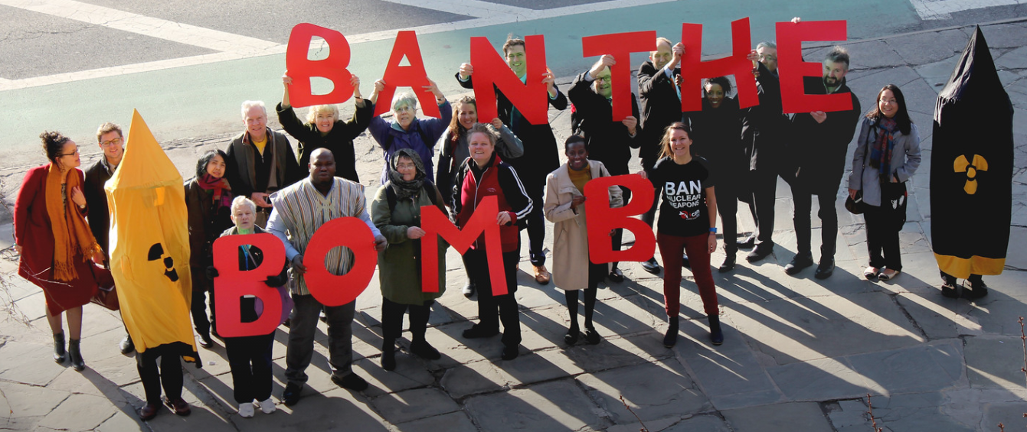
ICAN: International Campaign to Abolish Nuclear Weapons
produced the
TREATY ON THE PROHIBITION OF NUCLEAR WEAPONS
Notes:
We must abolish nuclear weapons everywhere.

Slide 17
INTERNATIONAL CAMPAIGN TO ABOLISH NUCLEAR WEAPONS
Steering Group:
Acronym Institute for Disarmament Diplomacy. London, UK
African Council of Religious Leaders - Religions for Peace. Nairobi, Kenya
Article 36. London, UK
International Physicians for the Prevention of Nuclear War. Boston, US
Latin American Human Security Network. Buenos Aires, Argentina
Norwegian People's Aid. Oslo, Norway
Pacific Network on Globalization (PANG). Suva, Fiji Islands
PAX. Utrecht, Netherlands
Peace Boat. Tokyo, Japan
Swedish Physicians against Nuclear Weapons. Stockholm, Sweden
Women's International League for Peace and Freedom. New York, US
Notes:
These people and organizations are ICAN.. IPPNW and WILPF are longstanding leaders of Peace and Justice movements here in the US

Slide 18
ICAN Leadership Staff
Notes:
These are dedicated people on a mission. Not many old white guys here. That might make all the difference.

Slide 19
Text of the TPNW
The States Parties to this Treaty, Determined to contribute to the realization of the purposes and principles of the Charter of the United Nations, Have agreed as follows:
(Article 1 Prohibitions)
Each State Party undertakes never under any circumstances to:
(a) Develop, test, produce, manufacture, otherwise acquire, possess or stockpile nuclear weapons or other nuclear explosive devices;
(b) Transfer to any recipient whatsoever nuclear weapons or other nuclear explosive devices or control over such weapons or explosive devices directly or indirectly;
(c) Receive the transfer of or control over nuclear weapons or other nuclear explosive devices directly or indirectly;
(d) Use or threaten to use nuclear weapons or other nuclear explosive devices;
(e) Assist, encourage or induce, in any way, anyone to engage in any activity prohibited to a State Party under this Treaty;
(f) Seek or receive any assistance, in any way, from anyone to engage in any activity prohibited to a State Party under this Treaty;
(g) Allow any stationing, installation or deployment of any nuclear weapons or other nuclear explosive devices in its territory or at any place under its jurisdiction or control.
Notes:
Small portion, directly copied from the TPNW. Sections e and f replace controversial earlier versions that specifically prohibited financing, but do that task. Don’t Bank on the Bomb is the coalition that monitors the financial involvement of corporations in the manufacture and development of nuclear weapons worldwide, and publishes freely everything it finds.. Go to www.dontbankonthebomb.org

Slide 20
The Treaty on the Prohibition of Nuclear Weapons opened for signature at the United Nations in New York on 20 September 2017 and entered into force on 22 January 2021.
There are currently 86 signatories and 56 states parties. (The states parties are signatories whose governments have ratified their nation’s adoption of the treaty.) It is expected that more nations will sign on, as these next proceedings take place, in 2021 and beyond.
The first meeting of states parties to the UN Treaty on the Prohibition of Nuclear Weapons will take place at the United Nations Office in Vienna from 22 to 24 March 2022.
The President-designate of the meeting is Austria's Alexander Kmentt.
At this inaugural meeting, States parties to the TPNW will gather to commit to concrete actions to implement obligations under the Treaty, including
providing assistance to victims of nuclear weapon use and testing,
beginning to remediate contaminated environments (Article 6) and
universalising the treaty (Article 12).
It will also be an opportunity for States to discuss some of the treaty’s technical details,
like setting a deadline for the elimination of nuclear weapons for nuclear-armed states that join (Article 4).
Notes:
Next March, in Vienna, Austria, good things will start happening.

Slide 21
Antigua and Barbuda 25 November 2019
Austria 8 May 2018
Bangladesh 26 September 2019
Belize 19 May 2020
Benin 11 December 2020
Bolivia 6 August 2019
Botswana 15 July 2020
Cambodia 22 January 2021
Chile 23 September 2021
Comoros 19 February 2021
Cook Islands 4 September 2018
Costa Rica 5 July 2018
Cuba 30 January 2018
Dominica 25 September 2019
Ecuador 25 September 2019
El Salvador 30 January 2019
Fiji 7 July 2020
The Gambia 26 September 2018
Guyana 20 September 2017
Holy See 20 September 2017
Honduras 24 October 2020
Ireland 6 August 2020
Jamaica 23 October 2020
Kazakhstan 29 August 2019
Kiribati 26 September 2019
Laos 26 September 2019
Lesotho 6 June 2020
Malaysia 30 September 2020
Maldives 26 September 2019
Malta 21 September 2020
Mexico 16 January 2018
Namibia 20 March 2020
Nauru 23 October 2020
New Zealand 31 July 2018
Nicaragua 19 July 2018
Nigeria 6 August 2020
Niue 6 August 2020
Palau 3 May 2018
Palestine 22 March 2018
Panama 11 April 2019
Paraguay 23 January 2020
Philippines 18 February 2021
Saint Kitts and Nevis 9 August 2020
Saint Lucia 23 January 2019
Saint Vincent and Grenadines 31 July 2019
Samoa 26 September 2018
San Marino 26 September 2018
Seychelles 9 July 2021
South Africa 25 February 2019
Thailand 20 September 2017
Trinidad and Tobago 26 September 2019
Tuvalu 12 October 2020
Uruguay 25 July 2018
Vanuatu 26 September 2018
Venezuela 27 March 2018
Vietnam 17 May 2018
States Parties to TPNW and effective dates
TPNW became International Law January 22, 2021
Notes:
These are our heroes now.

Slide 22
So, what is our task?
We the people of the United States must work like we never have before,
Lobbying Congress,
Informing and encouraging our fellow citizens that the madness must finally end.
Our nation must join the international community in banning and abolishing all nuclear weapons.
The world is offering us a solution to one of the great existential threats to life on earth, the one we Americans created, and it is time we accepted their help, and join the
Treaty for the Prohibition of Nuclear Weapons
in good faith.
Notes:
Somehow, we must get the people of the United States onboard.

Slide 23
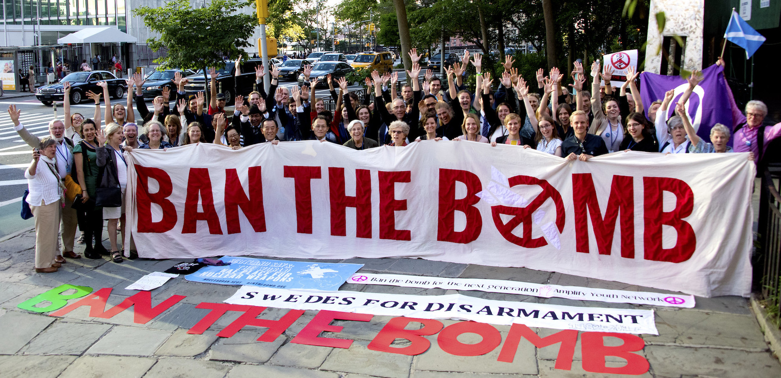
www.icanw.org
Notes:
This is our only hope.

Slide 24
These are two international peace and disarmament groups who have been around for decades, and are leading the current efforts:
Womens’ International League for Peace and Freedom : https://www.wilpf.org/
International Physicians for the Prevention of Nuclear War : https://www.ippnw.org/
More recent leader in nuclear disarmament is International Campaign to Abolish Nuclear Weapons:
They produced the Treaty Prohibiting Nuclear Weapons: https://www.icanw.org/the_treaty
To learn more about which corporations are financing the nuclear weapons and the vehicles that deliver them, as well as research and development for all things military, worldwide, Don’t Bank on the Bomb : https://www.dontbankonthebomb.com/ Especially for divestment.
Here in the US, Physicians for Social Responsibility local chapter WPSR and Washington Coalition to Abolish Nuclear Weapons, of which we are a member organization : https://www.wanwcoalition.org/
Also in the US, Beyond the Bomb https://beyondthebomb.org/ and Code Pink https://www.codepink.org/
Very Active group in Kitsap County is Ground Zero Center for Non Violence, https://www.gzcenter.org/
And us : https://www.nomorebombs.org/
Please join this important mission, any way you can. Contact us or any of these groups with your ideas and suggestions. Our website has links to more groups as well. Just as importantly, please share with family and friends. We are all in this together.
Notes:
Here are a few groups we can join up with, as a group, as a community, as individuals. It will be a huge task, it requires lots of people.

